Slide 1
GRAPH2SEQ: GRAPH TO SEQUENCE LEARNING WITH ATTENTION-BASED NEURAL NETWORKS
ICLR 2019 Conference
Kun Xu, Lingfei Wu, Zhiguo Wang, Yansong Feng, Michael Witbrock, Vadim Sheinin
2020-04-02
JuHyoung Kim
kjhkjh75@naver.com

Slide 2
- Process
Read Paper
Understand and run the code
Apply idea to code

Slide 3


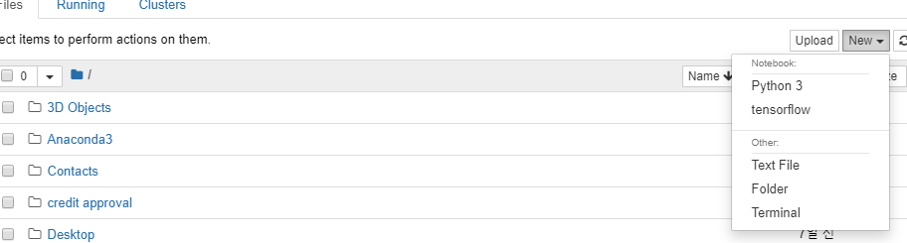
- Version issue
- Python 3.5
- Tensorflow 1.8
- Jupyter virtualenv

Slide 4
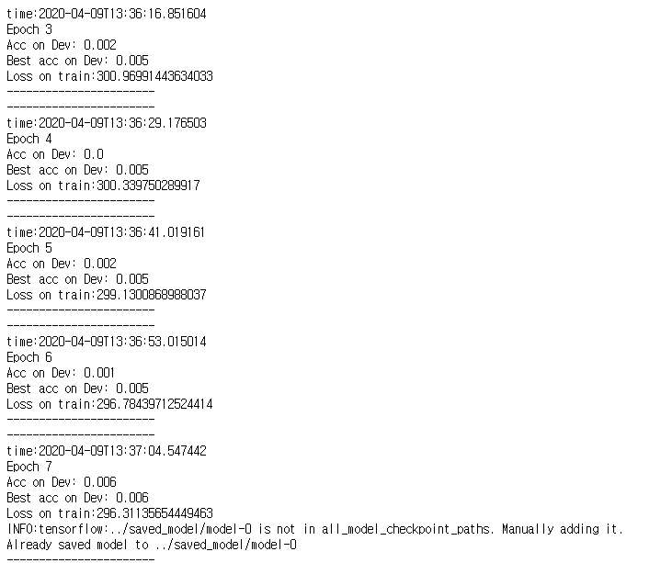
- Version issue

Slide 5
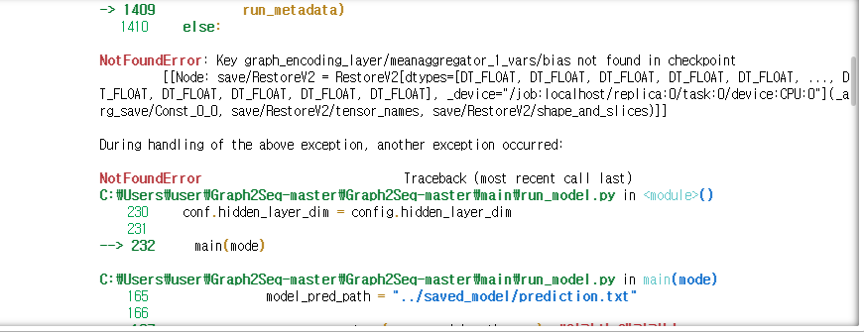
- Error issue
- Run the test session.

Slide 6
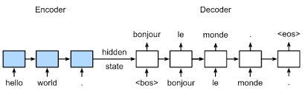
- Idea
Sequence problem
1. can`t represent relation among methods.
2. time step process.

Slide 7
- Idea
Class
Method
Method

Slide 8
- Idea
Method, variable - >abstraction.
identifier, op - > original code.
- Copy mechanism?
can process similar syntax organization without considering
name.

Slide 9
Future work.
Construct algorithm
Apply to code.

